Slide 1
FTC Software Intro (Robotc)
Team 5220 Roboknights

Slide 2
Outline
Getting Started
Hardware Setup/Wiring
Software Setup/Pragmas
Programming with RobotC
Grammar/Syntax
Basic Statements
Programming constructs, logic, etc.
Style, organization
Top 5 problems

Slide 3
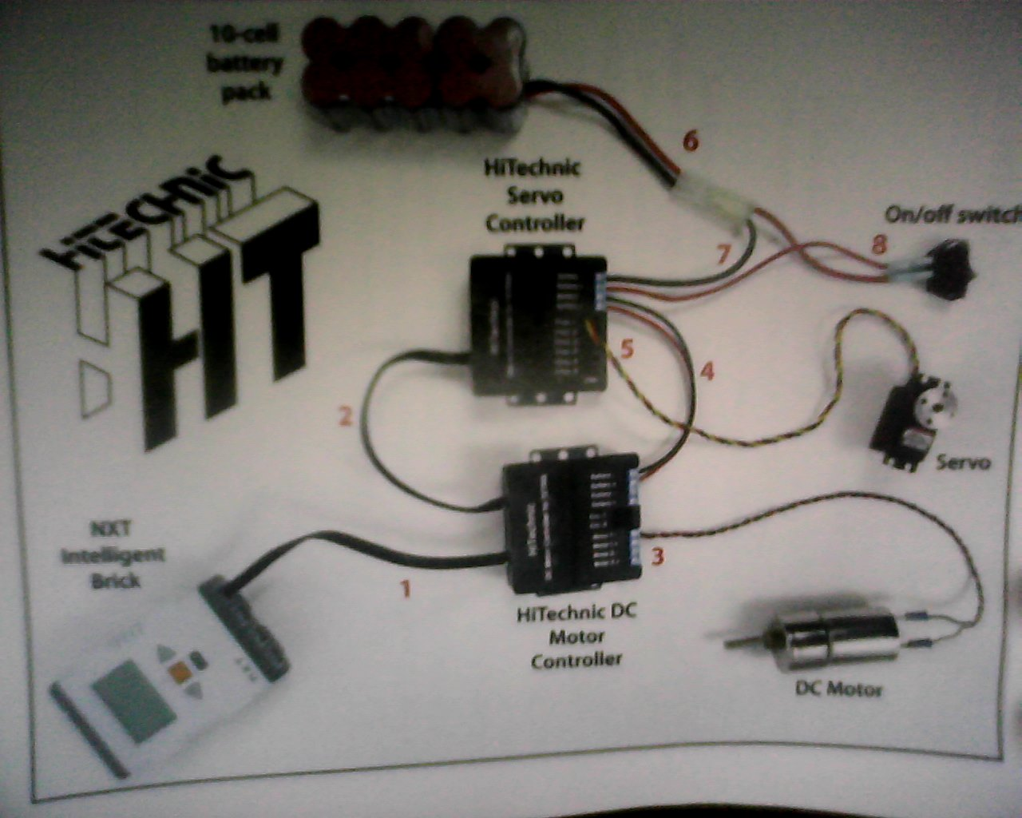
Wiring
Basic Setup:

Slide 4
Software Setup
Pragmas – EXTREMELY IMPORTANT!
Connecting the robot by Bluetooth
Turn on Bluetooth on computer and robot
Add robot under “Bluetooth devices” on computer
Go to “Communication Link Setup” in RobotC
Select Robot and connect

Slide 5
RobotC Syntax (“Grammar”)
The statement:
Each statement tells the program to do something, e.g. move a motor.
Statements can have parameters
Statements are separated by semicolons.
Lot of statements are pre-defined for you: if you think there should be a statement to do something, there probably is. Use google.
Blocks, compound statements, curly brackets {}

Slide 6
RobotC Syntax Continued
Tasks
task main: This is what actually runs
Creating new tasks
Using your tasks: StartTask and StopTask
Multithreading
Functions
Similar syntax to tasks – Notable differences:
Wait for completion
Parameters
Returning a value

Slide 7
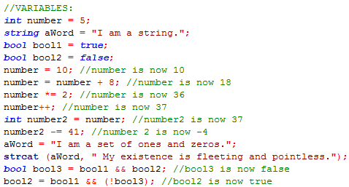
Variables
Variables are what we use to store data throughout the program.
Declaration, e.g. int x;
Assignment operator, =
+=, ++, --
Using variables
Most common variable types:
Int: integer
Double: decimal number
String: string of characters, text segment
Bool: boolean, true or false
Global vs. Local

Slide 8
RobotC Basic Statements:
motor [motorName] = int power
Sets a motor to a certain power, from – 100 to 100.
servo [servoName] = int position
For a 180 degree servo, sets the servo position to the specified position, from 0 to 255.
For a CR servo, if position < 127, moves backwards, if position > 127, moves forwards, if position == 127, stops.

Slide 9
RobotC Basic Statements Continued:
SensorValue [sensorName]
Reads the value of the specified sensor
nMotorEncoder [motorName]
Reads the value of the specified motor encoder
wait1Msec (int time)
Stops the program at this statement for the specified amount of time in milliseconds.

Slide 10
RobotC Basic Statements Continued:
nxtDisplayTextLine (int lineNumber, string text)
And remember…
#define name value
Assigns the value to the name for the rest of the gram, e.g. #define Number 72 means that “Number” can be used anywhere that 72 would.
#include filename.extension
Adds the specified file as a header.

Slide 11
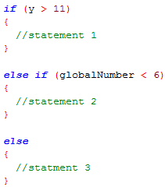
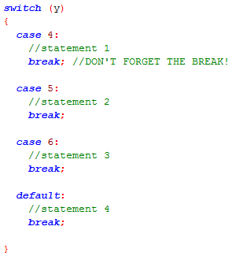
Flow Control
Boolean testing, true or false
if, else if, and else system
switch, case, and default system
Loops
while {} statement
for () statement
Break, continue, and return: Escaping from the flow

Slide 12
Compiling and Errors
Compiling: turns RobotC code into machine code.
Errors: The bane of all programming:
Compiler
The compiler helps point out errors, yet it can be misleading. Forgetting one bracket might lead to a boatload of errors in other places!
Logical
Not noticed by compiler, kind of like speaking correct grammar, but conveying the wrong meaning, e.g. variable x is 1 when it should be 2.

Slide 13
Style and Organization
Standard Casing: Capital word-breaks for tasks, camel case for functions and variables
Name your variables sensibly!
Make code re-usable, e.g. code to move motors a certain distance belongs in a function
Add spacing, line breaks and indentation so you can read the code.
Store values used in multiple places in variables/constants that can easily be changed.
Comments: // and /*

Slide 14
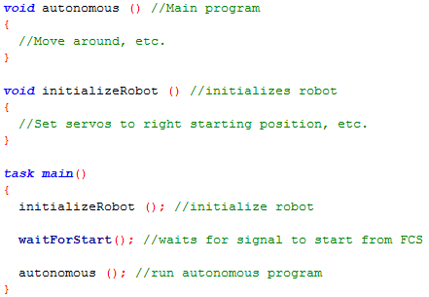
Typical Autonomous Program Format:

Slide 15
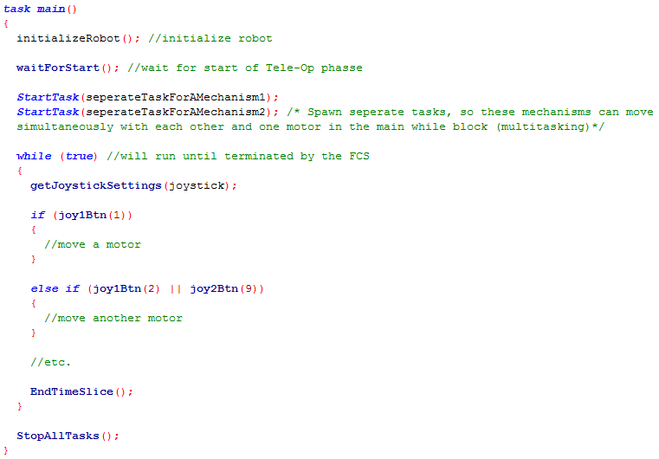
Typical TeleOp Program Format:

Slide 16
Top 5 annoying problems
Pragma Errors – especially when using encoders.
Locating logical errors – especially when logic in program is complex
Inconsistency of motor distances: Solve with encoders and sensors
Motors burning out: If nothing is moving, don’t try to move the motor more!
Messy / Hard to change code: Think of organization from the beginning.

Slide 17
Contact Info
Website (with slides and example code):
www.theroboknights. com
Email:
theroboknights@gmail.com

Slide 18
Thanks For Watching!
Any Questions?

